Slide 1
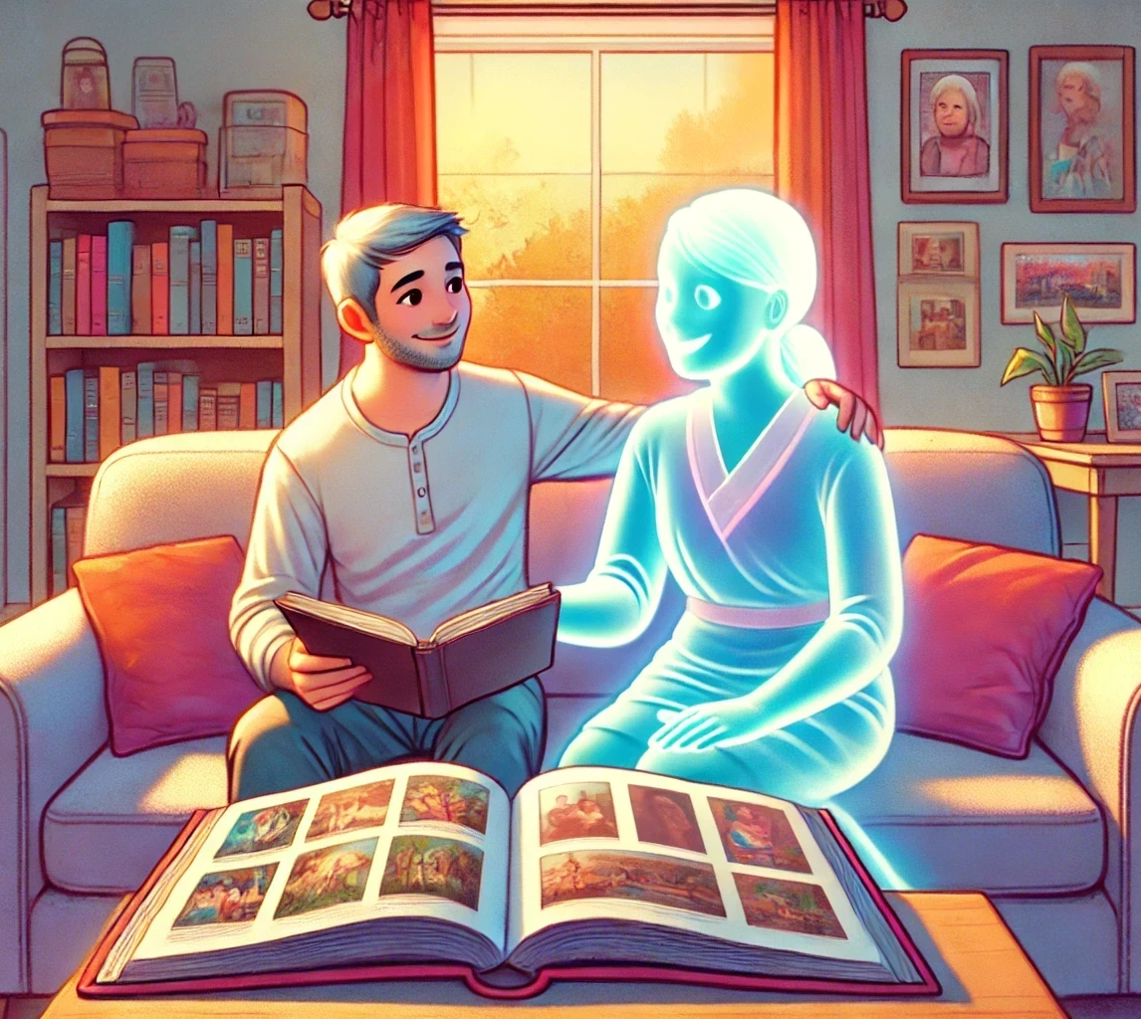
Family History in Every Season
Building Relationships Across Generations
Notes:
When I was asked to teach a fifth Sunday temple and family history lesson I thought it was kind of funny because I don’t actually do genealogy. I know how to open up Family Search and poke around a little bit, I know how to look people up in census records and I know I have the right skillsets to really be good at genealogy. But I don’t do genealogy. Why?

Slide 2
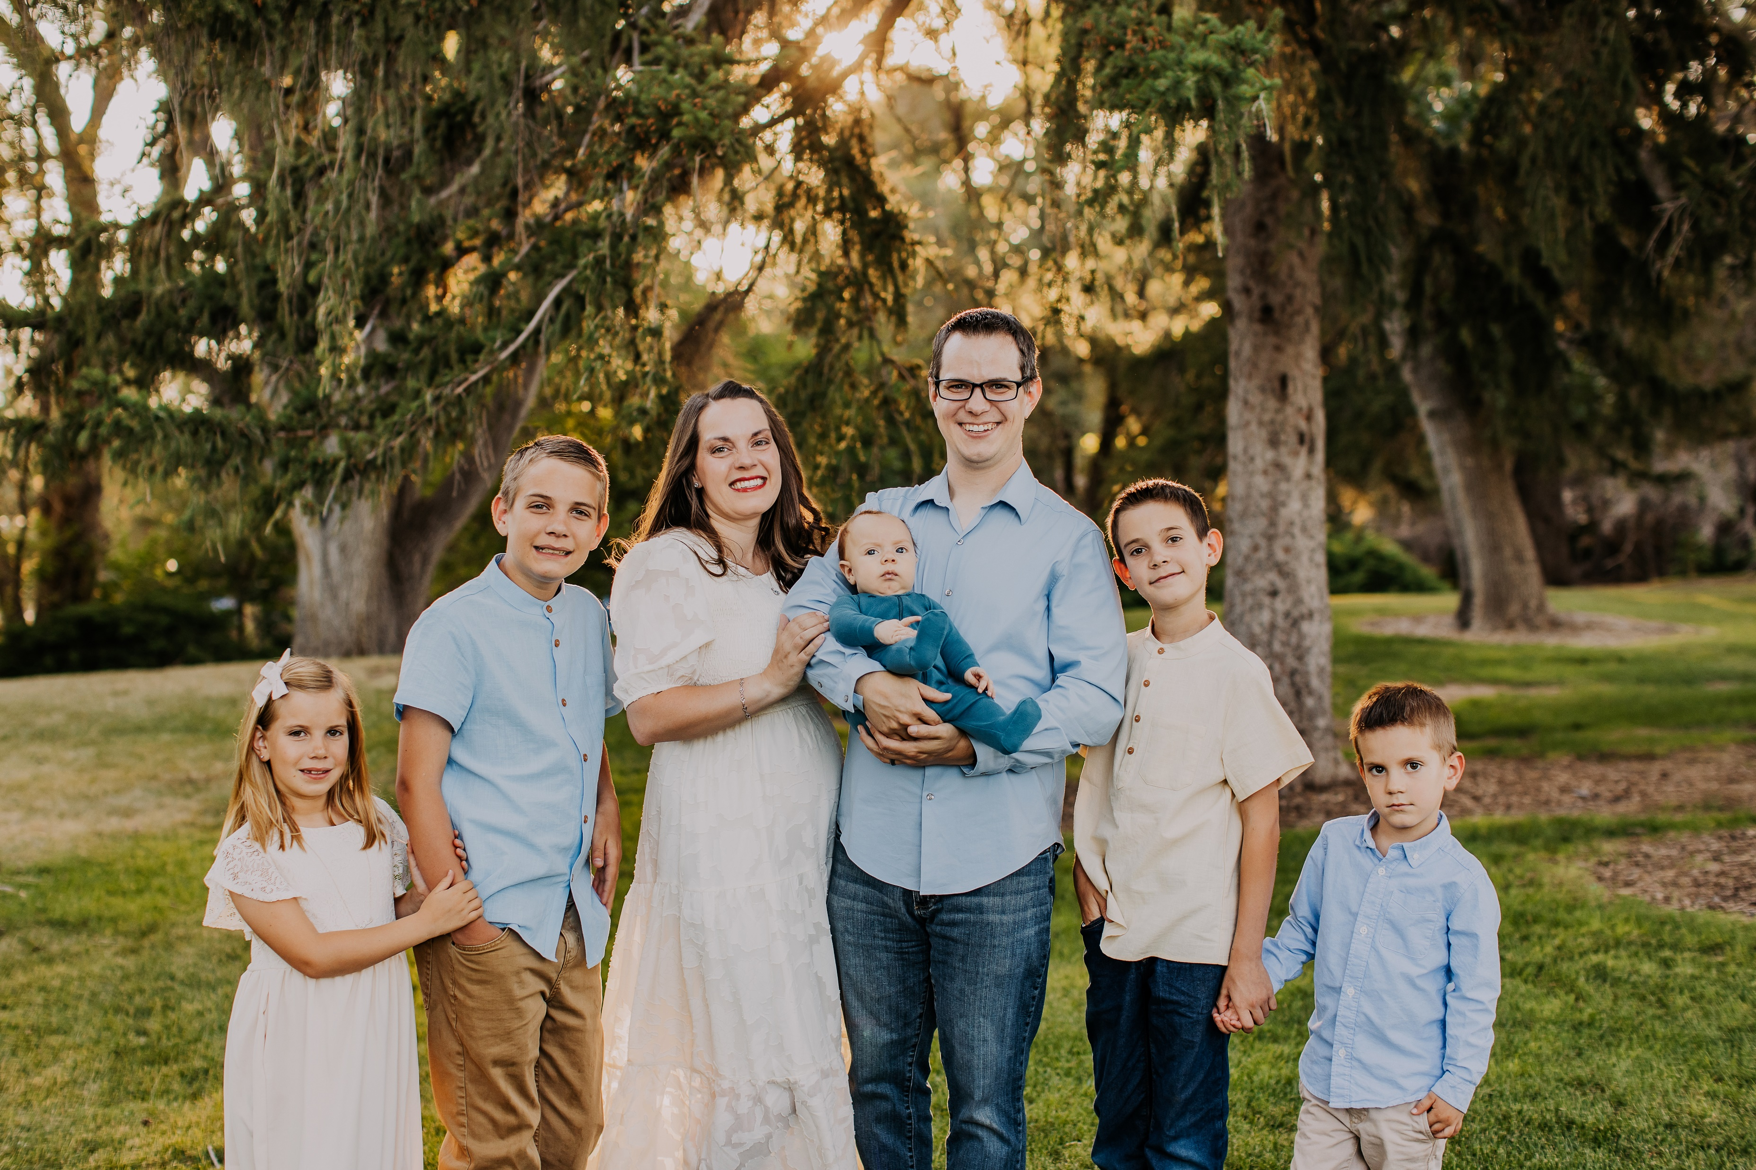
Times & Seasons
Notes:
Because right now I feel like my part of doing genealogy work is in the branches rather than the roots. Rather than feeling guilty that I’m not spending my time finding my ancestors I’ve embraced the fact that I’m devoting my time to their descendants – and that’s ok! When I was growing up my grandma was the family genealogist and my mom didn’t have the time to order microfiches and fill out pedigree charts. Today my mom has moved into her genealogy era and I’m the one running to soccer games. But I know that one day I won’t have soccer games to run to and I’ll be the one ordering copies of death certificates to fill in the charts. I know that sometimes we have family history lessons and if you’re not in your genealogy era you might be tempted to pull up candy crush and tune out – but I hope today that we can help you find ways that you feel you can be a part of family history in whatever era you’re in today. I’m not going to tell you that you have to do all the research if research isn’t your thing, or attend the temple every single day. But there is *something* each of us can contribute to this work and I hope to help you find something that you can do in your present era.

Slide 3
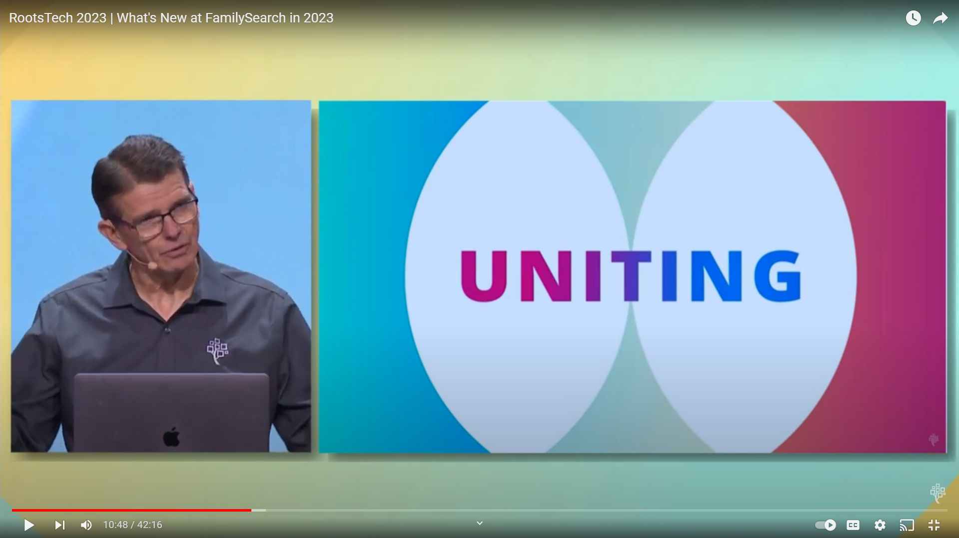
Notes:
As we started to put this lesson together my mom told me about this video clip that she saw at Roots Tech a couple years ago. The original presenter wasn’t able to make it to the convention so at the last minute they pulled in an engineer to give this breakout session. Now, I’m a computer programmer and I know that the last thing you want at your big convention is to pull out the engineers and make them talk. Engineers are rarely people people, they are happy to hide in a closet and build cool things but please don’t make them talk to someone about it. But what this engineer had to say completely changed the way my mom looks at family. The video was too long to watch here and there wasn’t like one little clip that showed the point. At the beginning of his presentation he told the audience that what they’re doing is all about building relationships and uniting families. He went on to talk about all of their different updates and each time showed how each tool and feature was created with the object of building relationships. If you’ve used the “find my relatives” feature before it might seem kind of silly – unless you understand that the idea isn’t necessarily to help fill out a chart but to connect you to other people.

Slide 4
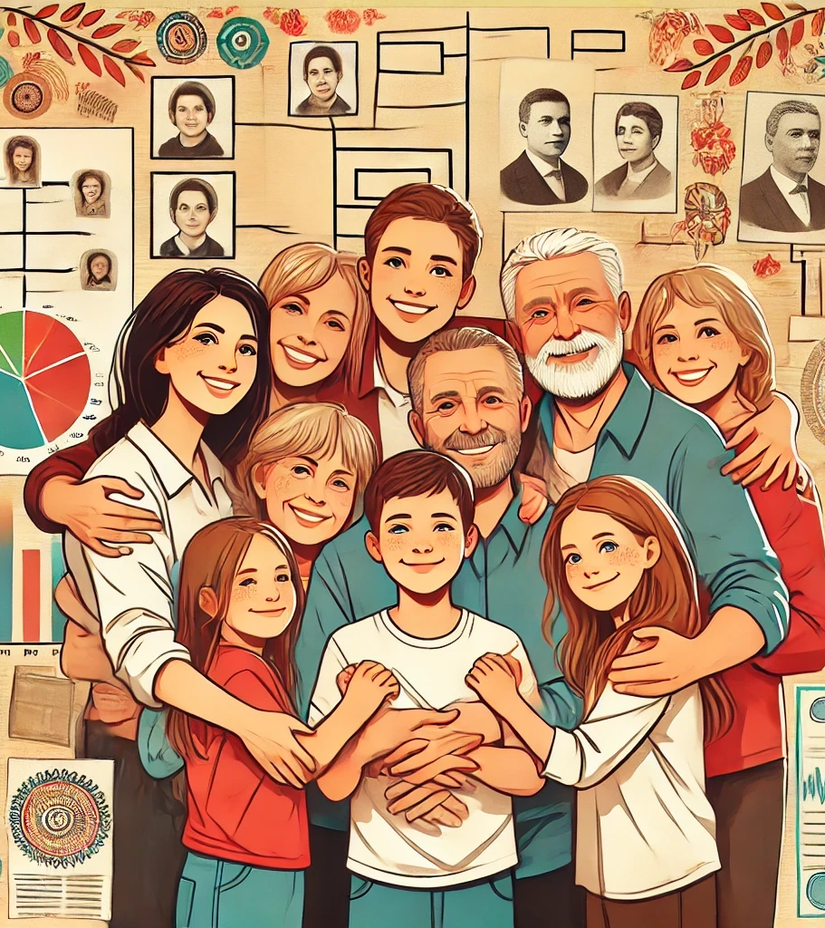

Notes:
So that’s what I want to focus on today - it’s all about relationships. It’s not about charts, or records, or checking boxes at the temple – it’s about relationships. If you take nothing else away from our lesson today THAT is what I want you to take away. Temple & Family History work is about building relationships. I told you that I don’t do genealogy, but one of the ways I contribute to our family history work is by trying to still build relationships on both sides of the veil. Obviously the ones with my own living family feel the most important, but I try to treat my ancestors as real people because… they are. I can’t be the one digging through records right now but I try to do my part to listen to my mom when she’s discovered a new line or wants to show off the pictures she got from her dad. I may not be finding the people myself, but I try to always cherish the memories or tidbits of information that I can learn about those that have gone on before so that I can build a little bit of a relationship with them.

Slide 5
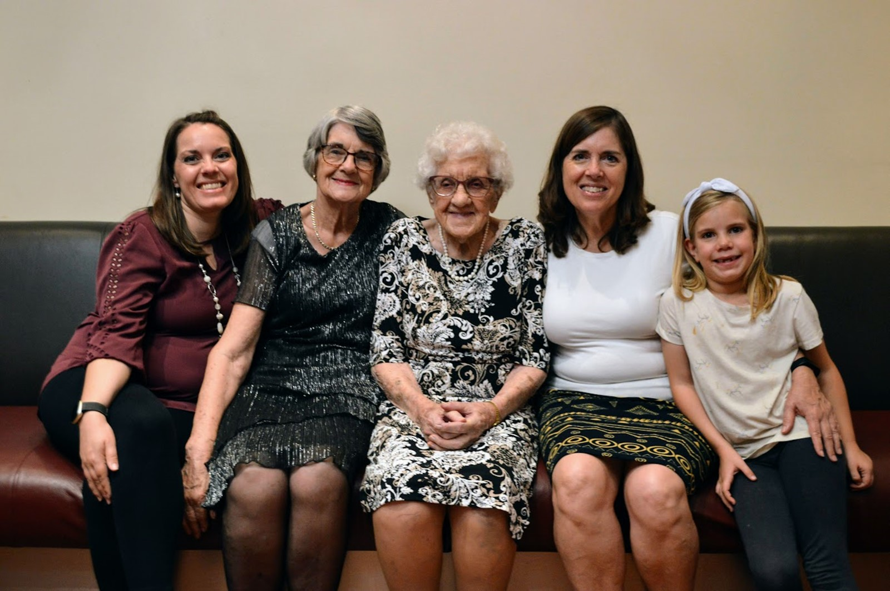
What are you doing to build relationships on both sides of the veil?
How have you felt connected to ancestors in meaningful ways?
Notes:
I would like for us to discuss a little bit how we build those relationships with those who have come before us. I thought I would start by telling you some of my own experiences and then open it up to discussion – so be thinking about those questions so you don’t have to listen to me for the whole meeting. This picture shows some women who are an important part of my personal family legacy. You can probably recognize me and Maeli on either end of the picture. If you think Maeli looks like she might have just been crying that’s because we’d just done a gender reveal for Caleb and she’d just discovered that he was NOT going to be the sister that she was hoping for. Likely you can pick out my mom next to Maeli. Next to me is my grandma, and there in the middle is her mom – my great grandma. Pretty cool to get a picture with 5 generations of women all together!
Almost 2 years ago we went as a family down to Australia to celebrate my great grandma Kitty’s 100th birthday. We were a little bit late because of COVID restrictions and she was actually closer to 101 but it was such a treat to get to introduce my kids to their great great grandma. Grandma Kitty is pretty feisty – in the middle of COVID in Australia they had restrictions that made it so that you were only allowed to go to the grocery store on particular days based on where your name fell in the alphabet or something like that. One day she told my grandma that she was pop down to the shops and my grandma said, “Mom, you can’t do that, it’s not your day to be allowed to go!” My great grandma replied, “I’m 99 years old, what are they going to do to me? I’ll just act confused and tell them ‘Oh sorry love, I don’t understand all these new protocols.’ and they’ll let me shop” Don’t stand between an old lady and the grocery store when she wants to go! She was still living on her own when we went to visit her at 101.
I don’t know how many people here have personally known their great grandparents personally but when I was born I had 5 of my 8 great grandparents still living – I’m the oldest child of an oldest and 2nd oldest child so the gaps are a little more condensed. On the other hand Eric is the youngest of 9 kids – his great grandparents were long since gone by the time he came around. Only Sam and Danny were able to meet his Grandma Hansen, but they were too little to remember even that meeting.
A great grandparent might seem fairly removed from you personally if you haven’t had them in your life, but my great grandparents are people I feel very connected to. I can remember my Grandma Bonnie playing sports with her grandkids. I remember my Grandpa Tom whistling for the lorikeets in his backyard. I remember my Great Grandpa Anderson visiting our home in California and insisting on working in the yard – despite being well into his 90s and my mom being convinced it would be the thing that killed him and that the family would hate her forever. I remember the raspberries in my Grandma Arlene’s backyard that we would pick while my parents would visit with them inside.
These are very real people. Despite Grandma Kitty being the only one of those great grandparents still alive – she’s kicking around now at 102 – I know that all of them were invested in me while they were here on earth – and I can’t imagine that investment disappeared just because they passed through the veil. I think of my relationships with my own kids. I may not know a lot about what happens in the next life but I do know that it would take a lot more than death to erase the love I have for them. We may not remember these people but I know that they remember us and I am certain that they play a very active role in our lives, even though we don’t necessarily always see their hands in our lives.
So what about you, has anyone had experiences where they have felt the continuation of relationships beyond the veil, or found ways to build relationships with family members that you have never met?

Slide 6
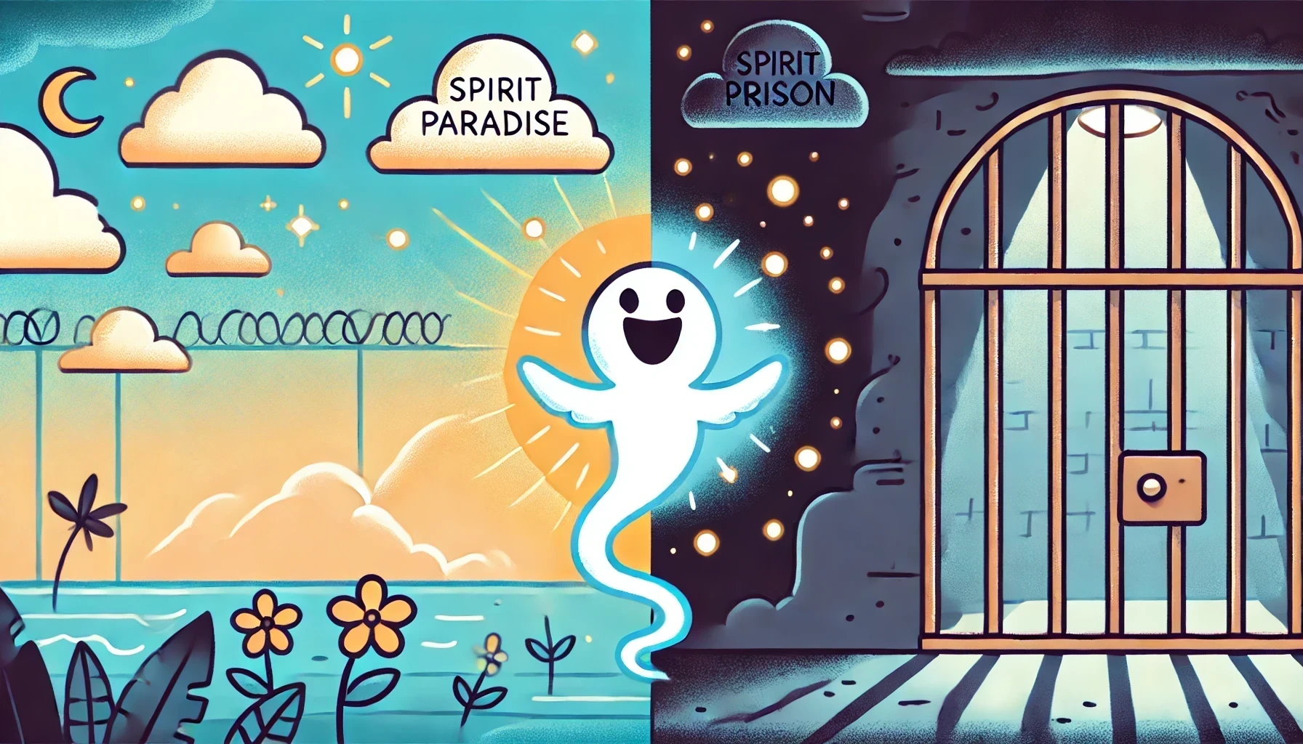
Notes:
I’ve asked a few people to help me with this next part. I would like to share with you some stories of families from how my mom has built our family relationships and tree and gotten families to the temple. But I thought it would be more fun if you could see real people to represent them and we can try to take them to the temple. So if those who I’ve asked to act as family members for this could come up. We’re going to start with everyone here in spirit prison and they can come and tell you their stories and try to get them to spirit paradise.
--------- Script for “Does anyone have my name?” participation section ------------
My name is Simeon Allen. I was born in 1779 in Franklin Massachusetts. Does anyone have my name?
My name is Elizabeth Leavens. I am the wife of Simeon Allen and together we had 4 children. Does anyone have my name?
My name is Jude Allen. I am the oldest son of Simeon & Elizabeth. Does anyone have my name?
My name is Emily Allen. I am the oldest daughter of Simeon and Elizabeth. Does anyone have my name?
My name is Ira Allen. I am the third child of Simeon and Elizabeth. I joined the church in ____ and was able to do my own temple work during this life.
My name is James Allen. I am the youngest child of the family. Does anyone have my name?
My name is Joseph Cabella. All that is remembered about me is that I died in a shipwreck in 1874 and I was born in 1841. Does anyone have my name?
My name is Hannah Waller, I am the wife of Joseph Cabella. Does anyone have my name?
My name is Isabella Hilton Cabella, I am the daughter of Joseph and Isabella. Does anyone have my name?
My name is Rose Hannah Cabella, I died shortly after birth and my mother died along with me. Does anyone have my name?
My name is Cyril Horsefall Challoner. I was born in England in 1906 as the 8th of 9 children to James Fleetwood Challoner and Gwendoline Bayldon. My wife, daughter and I were killed in 1940 in the German bombings of World War 2. Does anyone have my name?
My name is Gladys Platt. I am the wife of Cyril. Does anyone have my name?
My name is Thelma Gladys Challoner. I am the only daughter of Cyril and Gladys. Does anyone have my name?
My name is Thomas Lusitania Smith. I was a member of the Church of Jesus Christ of Latter-day Saints throughout my life and was involved in doing a lot of genealogy. I passed away in 2015 and I have since reconnected with my biological father who I didn’t know in this life and my son who I was estranged from. I was able to do my own temple work while I was on the earth, but I couldn’t share My father’s name is Leopold Hirschberg – does anyone have his name? My son’s name was Peter Halpin – does anyone have his name?
--------------
I don’t know about you but no matter how many people we get over to the spirit paradise side I feel heartsick for anyone who was left over in spirit prison. There was another family that I considered sharing but they had 9 kids and we don’t have any families that big in the ward to represent them. The family was relatively easy to find – their work had been done for years. However years later my mom discovered that they were missing 2 more children whose records weren’t so easy to find. As a mom – the idea of missing any of my children is devastating. Of course I would be happy to have 4 of my children sealed to me – but if I was missing any one of them I feel like that would be all consuming. While an 80% might be a passing grade in school, missing just one of my children would feel like a 0%. It makes me understand more and more why we talk about the Savior leaving the ninety and nine to rescue the one. I’ve asked my mom to share the stories of how she was able to find these people so that their work could get done too.

Slide 7
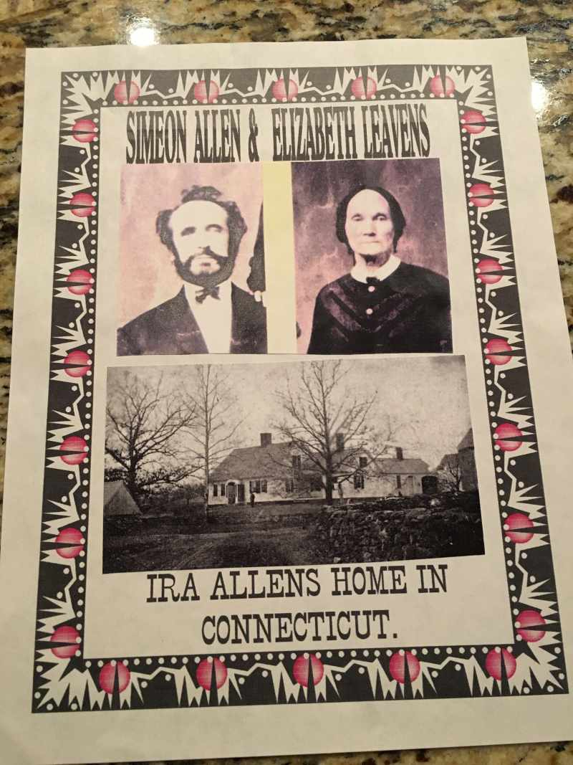
Finding the Ira Allen Family
Notes:
The first family I shared was the family of my 4th great grandfather Ira Allen. Ira joined the church in 1845. The family that we had stand up were representing his parents and siblings. All of their work had been done back in the 1800's. They were easy to find because they were people that Ira would have known personally and he made sure their work was done himself.

Slide 8
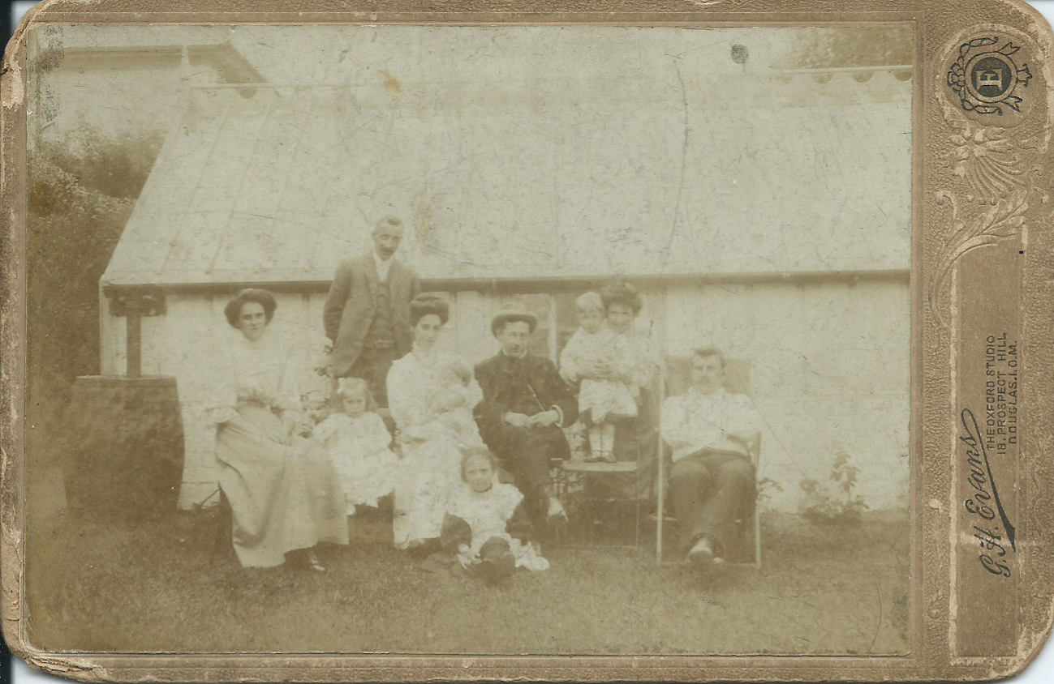
Finding Rose Cabella
Notes:
The next family was that of my 3rd Great Grandfather Joseph Cabella. He was a ship's captain that was lost at sea in 1847. His wife was pregnant at the time but the baby only lived for a few months after birth. The mother lived for 4 years longer before leaving their first child - who was only 8 years old at the time - an orphan. The father, mother and oldest daughter were easy enough to find - their oldest daughter was my 3rd great grandmother and her parents show up in the records plenty. Their work had all been completed in the late 1960s and 1970s. The baby though wasn't obvious to find. She doesn't show up on census records, she had no children of her own - there was no one to carry on her legacy. My parents found her through good old fashioned detective work. They felt like they ought to take another look at this family and really comb the records to make sure there was no one that was missed. Luckily Cabella isn't a very common last name so searching records in their area for that last name inevitably pulled up relatives, the trick was just finding how they fit. As they did this they came across a birth and death record for Rose. She never appeared on any census but she still appeared in those records. Her work was finally completed in 2010.
(At this point in the presentation I was going to have "Rose" stand back up and ask "does anyone have my name?" I had a friend in the audience who was handing out the names of these lost people who could then have them come forward and take them to spirit paradise.)

Slide 9
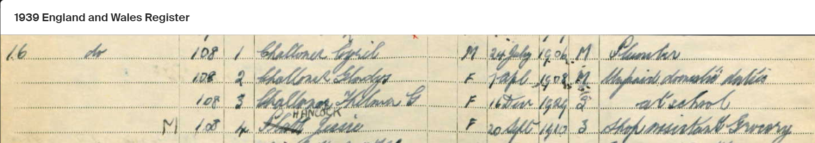
Finding Cyril Challoner's Family
Notes:
Cyril Challoner's family was more recent. He is the cousin of my great grandfather - one of the few great grandparents that I did not get a chance to meet in this life. While the other people that I highlighted were direct ancestors of mine, Cyril was a little more lateral. He, his wife and daughter were all killed during the bombings on England during WW2. They have no living descendants today. The only way they could be found was for us to explore more of our family tree than just our direct line.
(Have these people stand back up and ask if anyone has their names – someone in the audience should have handed out their names AFTER the first round was completed)

Slide 10
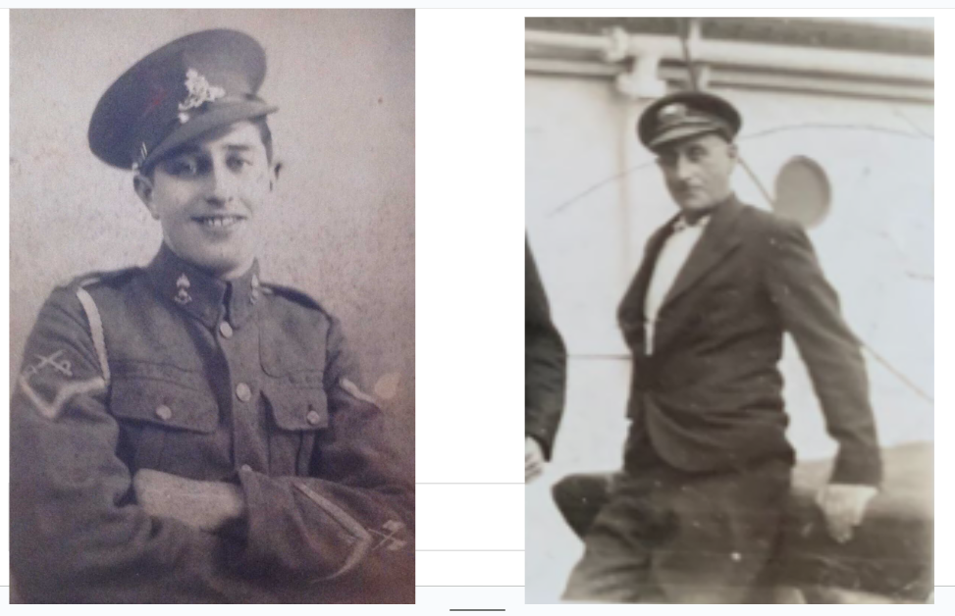
Finding Tom Smith’s Family
Notes:
The final family that we highlighted was my great grandfather Tom Smith. I talked about him earlier as the grandpa that I remember whistling for lorikeets in his backyard in Queensland Australia. You would think his genealogy would be super straightforward - he was a genealogist up until his death in 2014! We had the Smith line covered way way back and thought we were just working on branches that were going to be really hard to fill in because the records from so long ago would be difficult to find.
Then, after my grandfather's death my mom did an Ancestry.com DNA analysis. Her report came back that she had Russian Jewish ancestry. Huh? How could that be? Slowly she was able to piece together that her biological great granddad was not the man that her great grandma was married to. Through a series of digging through records, comparing pictures, and talking with DNA matched relatives she determined that Tom Smith's dad was actually Leopold Hirschberg - a sailor who was living in Liverpool, England at the time. Tom's middle name of "Lusitania" suddenly made sense as his father survived the sinking of the Lusitania the year before his birth.
We actually found mention of Leopold in a book called Wilful Murder: The sinking of the Lusitania, however at the time he was using the name Leonard Thompson as a means of avoiding prejudice against his Jewish heritage. He was tricky to find with different names and no records that would confirm his identity but it was fascinating as we put some of these puzzle pieces together. We had joked for years that Grandpa Tom looked a lot like Tevya from Fiddler on the Roof and it was interesting to discover that we weren't far off - his ancestors came from a town very similar to Anatevka. This has opened up a completely different line of research for putting together our family history.
The DNA analysis also started connecting my mom with cousins that she didn't recognize. A little bit of sleuthing uncovered that during his military service in WW2 my grandfather had fathered a son in Ireland. The boy had spent his whole life searching for his dad but never connected to him. He had passed away before his father. We believe that this whole crew of estranged fathers and sons has been connecting on the other side and making up for the lost time they never got to have on earth. It has been an honor to reconnect them and restore these lost ties.

Slide 11
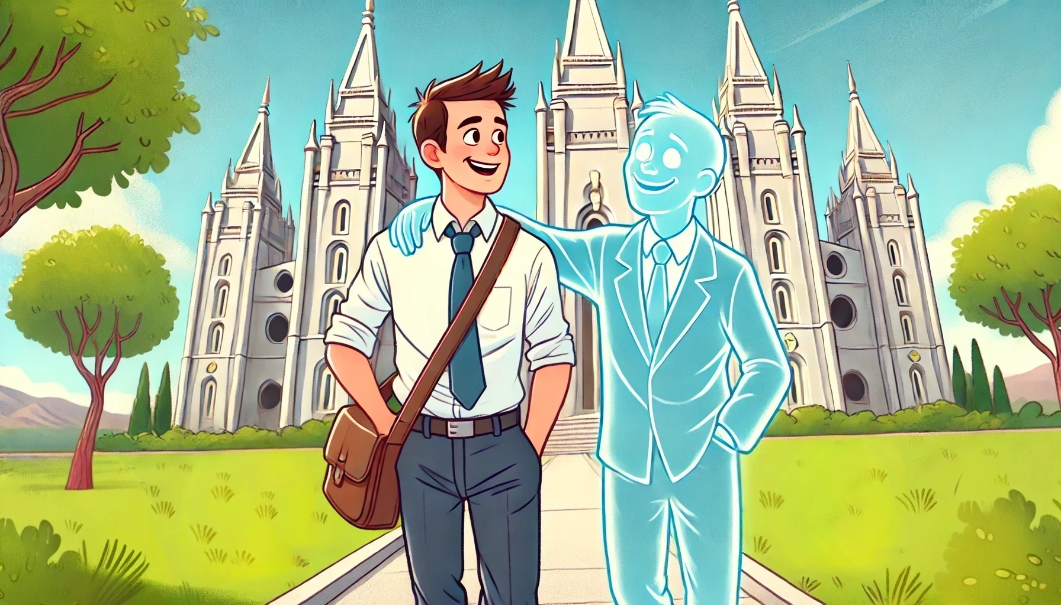
How do you make deceased loved ones feel real to you?
Notes:
I hope that watching these examples has helped you see how you can start to connect to your deceased loved ones. These are REAL people, even if we don’t remember them anymore. It has been said that you die twice – once when your heart stops beating and once when there is no one on the earth who still remembers you. Through reconnecting our families and taking those family members to the temple we help make it so that these people are not forgotten. I would like to discuss some of the ways that we can make deceased loved ones feel real.
One of the ways that I have found has been a simple change of semantics. I no longer take names to the temple – I always take friends. Now I know this sounds kind of hokey, and I will admit that when I started doing this, I felt really dumb about it. But I have forced myself to always talk about these people as friends rather than names. Whenever I’m ready to go to the temple I call up my mom and ask her if she has any of her friends that she wants me to take to the temple. I will tell you that even if I felt dumb calling them friends, after doing the work to find these people, learn their stories and put them back together – my mom feels zero irony when I ask her for a friend.
Whenever I can I try to have my mom tell me a little bit about the person whose work I am doing. At the very least I try to look at the card and see where they were from and how long they have been waiting for me to take them to the temple. While I’m waiting I try to at least take a second to close my eyes and say hi to them and let them know that I’m excited to be with them that day. My 13yo recently went to the temple after having my mom give him a little bit of information about the people he was doing work for. He came back telling me how much better it made the experience when he’d done the work to find someone himself.
-- Ask for other experiences with feeling like the people on the other side of family history work are real --

Slide 12
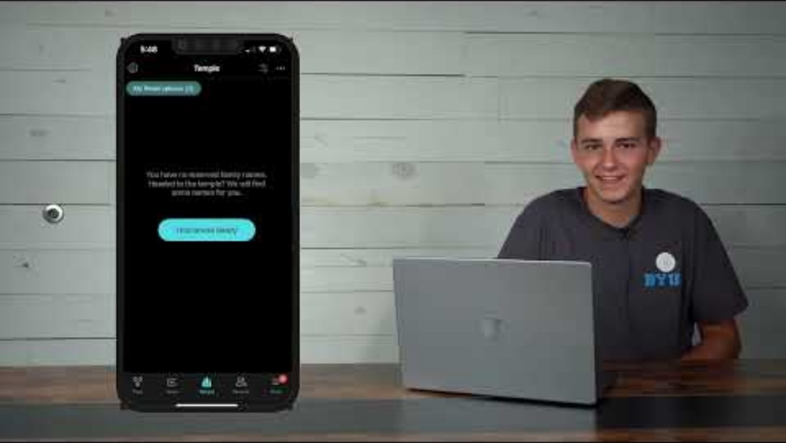
How find a friend to take to the temple
Notes:
I want to show you really quickly how to find your own family friend to take to the temple. It is so super duper simple, if you haven’t done it before you’ll be surprised how easy it is. I don’t want to spend too much time in the hows of family history – if you need help I know that our temple & family history committee is eager to help you with any of these road blocks. But I want to show you that it really is so easy so you can be brave to find your own friends next time you’re going to the temple. It is much more meaningful when you feel the connection to your own family while doing temple work. I found this video that will walk you through the process.

Slide 13
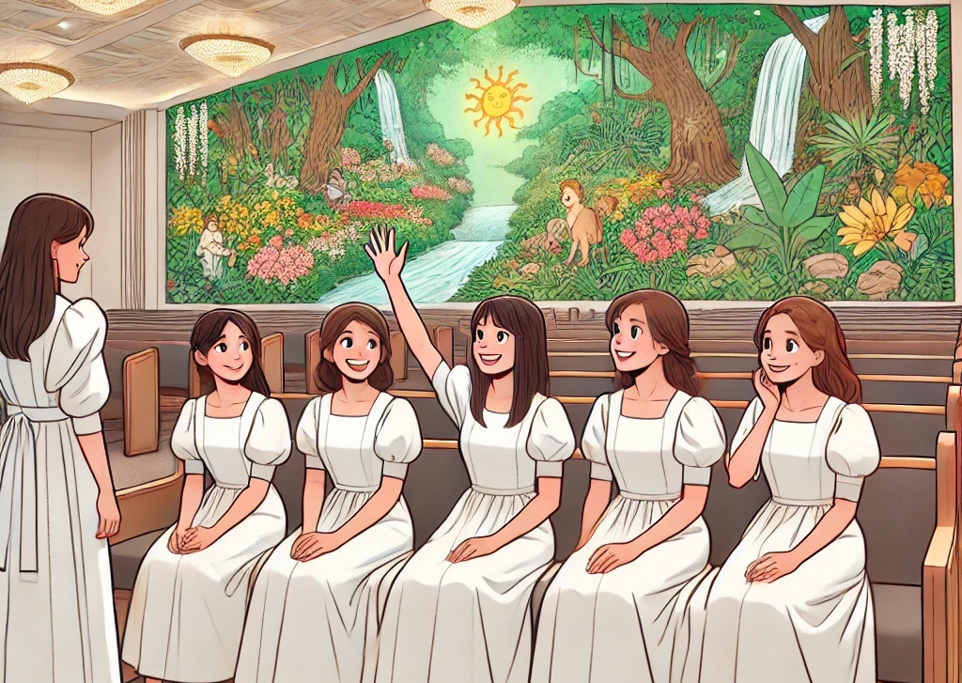
How do you find time to serve in the temple?
Notes:
Ok, now that you have a name you need a time to go to the temple. I’m going to put in a quick plug for Ward Temple Night. I was able to attend ward temple night last week and as I sat there I kept thinking “I really hope this is what heaven is like!” I love attending the temple, I love the peace that is there and the chance to serve, and just being somewhere with no one climbing on me for a little while. But attending with our ward was even better. As I walked into the chapel I saw sisters from our ward who scooted over and made sure there was a place for me. I was able to watch as a few other sisters walked in and literally with each person who walked in that I knew my heart swelled with happiness to see them there in the temple. It’s always great to go – but it’s even better when you can go and feel that love and connection with each other too. As I felt the happiness of seeing members of our ward family in the temple it made me think of how it must feel to see friends and family reunited on the other side of the veil and how much more excited we will be to see each other there. So, if you’re looking for a good time to go to the temple – it’s much more fun going with the ward. We try to schedule it for the 3rd week of the month and we vary between Fridays and Saturdays, different evening time slots, and switch it up between endowment sessions and sealing sessions. We usually even have treats afterwards! We try to get the information out in the RS Newsletter, the bulletin, GroupMe – anywhere we can as far in advance as possible so that it can get on your calendars. So what about everyone else? How do you find time to serve in the temple, and why is it ward temple night? Oh, I mean, whatever has been working best for you ;) – DISCUSSION --

Slide 14
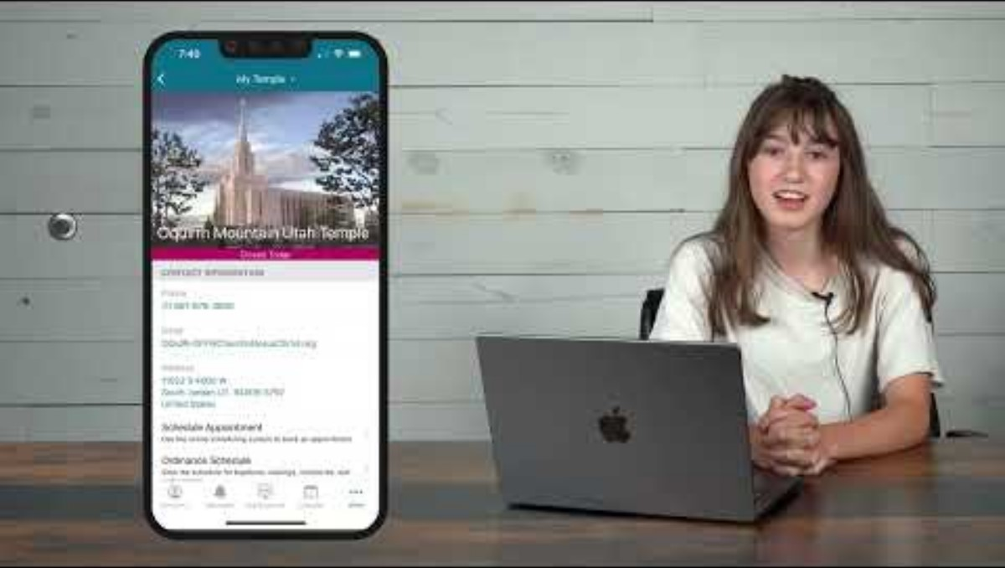
How to Schedule a Temple appointment
Notes:
I’ve heard some people say that they haven’t attended in awhile because they don’t know how to set an appointment. Here’s a really really quick walkthrough of how to do it so you don’t have that excuse any more ☺

Slide 15
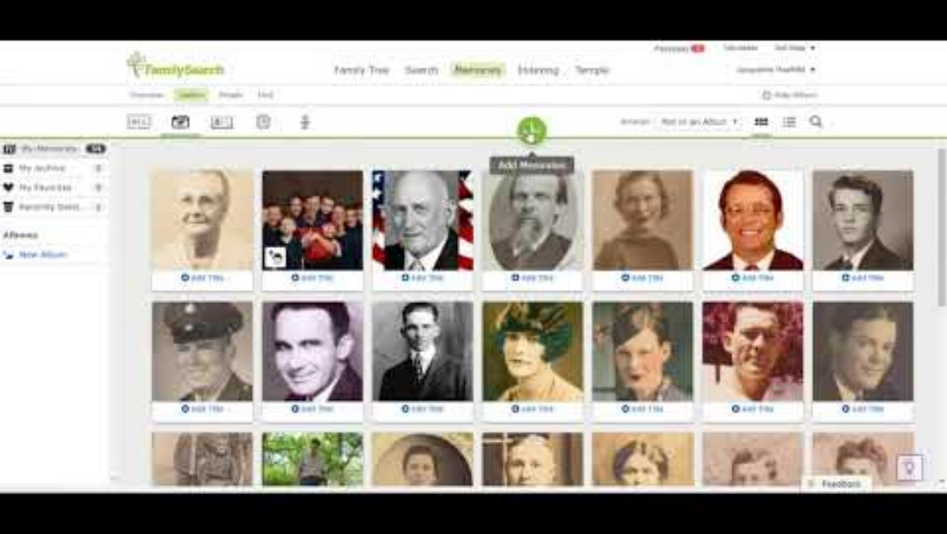
How to upload Memories to Ancestry
Notes:
One of the things that you might have noticed in my mom’s quest to put these families together is how she used memories in Family Search to piece things together. I’m going to ask her to jump in again to show how that works.

Slide 16
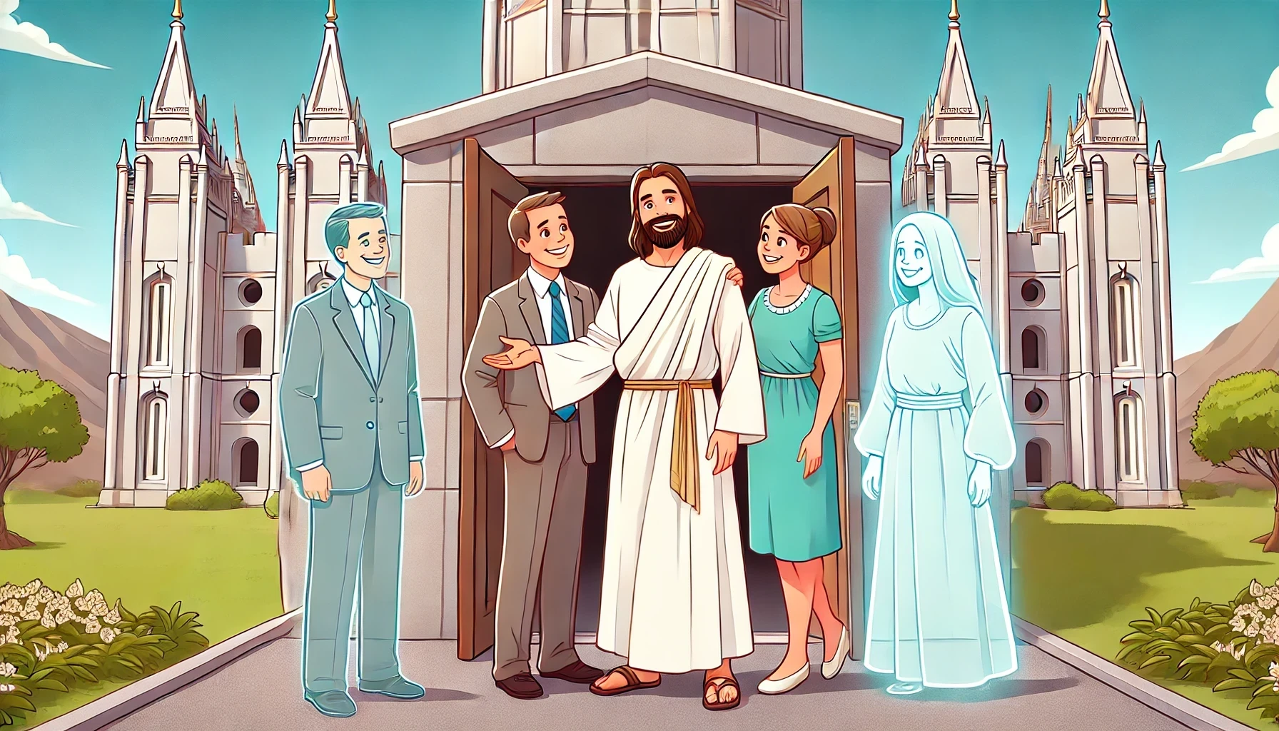
Notes:
As we close I hope you’ve learned something and hopefully caught a little bit of the vision of why family history is important to you and some way that you can be a part of it. I hope that you will go out feeling more that we are talking about real people when we’re doing family history and not just names on the page. I bear my testimony that I know that that is true. I know that the work that we do in temples is so important and that we need our ancestors and they need us. Life and salvation are a group project. In D&C 128:15 we read “And now, my dearly beloved brethren and sisters, let me assure you that these are principles in relation to the dead and the living that cannot be lightly passed over, as pertaining to our salvation. For their salvation is necessary and essential to our salvation, as Paul says concerning the fathers—that they without us cannot be made perfect—neither can we without our dead be made perfect.” I know our Heavenly Parents love us, and they love those who have come before us and those who will come after us. The Plan of Salvation is such a gift and it will not be complete until we have connected the whole human family. What a privilege it is to be a part of this great work. I leave these things with you in the name of Jesus Christ, amen.

